Slide 1
Lightning Network
Measuring Channel Capacity
29/04/2019

Slide 2
Are HTLC established on Payment Failure?
While attempting a payment, HTLC Are established first, then, on payment failure, they are cancelled.
Cancel an HTLC means that a new pair of commitment transaction are created invalidating the old one.
N0 -> N1 -> N2 with C12 having insufficient capacity. N0 attempt a payment to N2. N0 create an HTLC to N1, N1 realize that is not able to create an HTLC to N2 beacuse of insufficient capacity of C12. In this case lnd daemon instantly cancel off chain the N0->N1 HTLC when it realizes it can’t forward the HTLC
HTLCs are starving if the payment is starving.
Refs[ https://lists.linuxfoundation.org/pipermail/lightning-dev/2018-December/001752.html
https://github.com/lightningnetwork/lnd/issues/2943
https://lists.linuxfoundation.org/pipermail/lightning-dev/2015-July/000018.html]

Slide 3
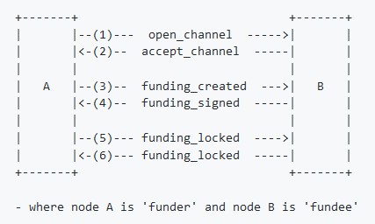
Channel Establishment
N0 ->N1 ->N2 Which information are exchanged between N0 and N1 to open a new channel? Which information does N2 recieve?

Slide 4
Channel Establishment
The open_channel Message
This message contains information about a node and indicates its desire to set up a new channel.
This is the first step toward creating the funding transaction and both versions of the commitment transaction.
type: 32 (open_channel)
data:
[32:chain_hash]
[32:temporary_channel_id]
[8:funding_satoshis]
[8:push_msat]
[8:dust_limit_satoshis]
[8:max_htlc_value_in_flight_msat]
[8:channel_reserve_satoshis]
[8:htlc_minimum_msat]
[4:feerate_per_kw]
[2:to_self_delay]
[2:max_accepted_htlcs]
[33:funding_pubkey]
[33:revocation_basepoint]
[33:payment_basepoint]
[33:delayed_payment_basepoint]
[33:htlc_basepoint]
[33:first_per_commitment_point]
[1:channel_flags]
The accept_channel Message
This message contains information about a node and indicates its acceptance of the new channel.
This is the second step toward creating the funding transaction and both versions of the commitment transaction.
type: 33 (accept_channel)
data:
[32:temporary_channel_id]
[8:dust_limit_satoshis]
[8:max_htlc_value_in_flight_msat]
[8:channel_reserve_satoshis]
[8:htlc_minimum_msat]
[4:minimum_depth]
[2:to_self_delay]
[2:max_accepted_htlcs]
[33:funding_pubkey]
[33:revocation_basepoint]
[33:payment_basepoint]
[33:delayed_payment_basepoint]
[33:htlc_basepoint]
[33:first_per_commitment_point]
Nb. The openchannel message in LND does not support the definition of: -Dust_Limit -Channel_Reserve_Sat -Max_HTLC_Value_in.. -To_self_delay -Max_accepted_HTLC -basepoint -chanels_flags

Slide 5
Channel Announcement and Update
N0 -> N1 -> N2
When a channel N0->N1 is established, N0 and N1 start to send an initial channel announcment message to their peers.
When N0 or N1 want to change their routing policy, they send a channel update message, which is then spread through the network. N2 recieve the initial channel announcement and all the channels update.

Slide 6
Channel Announcement and Update
Channel Announcment Message
[64:node_signature_1]
[64:node_signature_2]
[64:bitcoin_signature_1]
[64:bitcoin_signature_2]
[2:len]
[len:features]
[32:chain_hash]
[8:short_channel_id]
[33:node_id_1]
[33:node_id_2]
[33:bitcoin_key_1]
[33:bitcoin_key_2]
Channel Update Message
[64:signature]
[32:chain_hash]
[8:short_channel_id]
[4:timestamp]
[1:message_flags]
[1:channel_flags]
[2:cltv_expiry_delta]
[8:htlc_minimum_msat]
[4:fee_base_msat]
[4:fee_proportional_millionths]
[8:htlc_maximum_msat] (option_channel_htlc_max)

Slide 7
Channel Parameters Seen in Network Graph
"channel_id": "1661551185571086336",
"chan_point": "d3e62b9262dab27964d3eaced8d68ee9df50c325b92e02ee1394031945f811e1:0",
"last_update": 1556014085,
"node1_pub": "023b431c093e9599a17ee86f339f8f3105e5f69bdbe72b0a71f79635f1319731ef",
"node2_pub": "035639efb2bdd73ff6b82374a9d958c7ab404f8c1acb6dee678d9596e7cae25b2c",
"capacity": "100000",
"node1_policy": {
"time_lock_delta": 144,
"min_htlc": "1000",
"fee_base_msat": "1000",
"fee_rate_milli_msat": "1",
"disabled": false
},
"node2_policy": {
"time_lock_delta": 144,
"min_htlc": "1000",
"fee_base_msat": "1000",
"fee_rate_milli_msat": "1",
"disabled": false}
N0 ->N1->N2

Slide 8
Channels Parameters Seen by Nodes owning the Channel
"active": true,
"remote_pubkey": "023b431c093e9599a17ee86f339f8f3105e5f69bdbe72b0a71f79635f1319731ef",
"channel_point": "d3e62b9262dab27964d3eaced8d68ee9df50c325b92e02ee1394031945f811e1:0",
"chan_id": "1661551185571086336",
"capacity": "100000",
"local_balance": "99815",
"remote_balance": "0",
"commit_fee": "185",
"commit_weight": "600",
"fee_per_kw": "256",
"unsettled_balance": "0",
"total_satoshis_sent": "0",
"total_satoshis_received": "0",
"num_updates": "0",
"pending_htlcs": [
],
"csv_delay": 144,
"private": false}
N0 ->N1->N2

Slide 9
The Queryroutes Command
QueryRoutes attempts to query the daemon’s Channel Router for a possible route to a target destination capable of carrying a specific amount of satoshis.
N0->N1->N2
N0 queryroutes to N2 → N0 ask the lnd daemon the possible routes.
Refs[ https://api.lightning.community/#queryroutes ]

Slide 10
Double channel Announcment
The same channel ID NEVER appers twice in a result of a describegraph command ( which give the Network graph from the point of view of the executing node)
Different nodes, at the same time, can have different views of the network.
N0->N1->N2
N0 open a channel with N1 splitting the whole capacity in remote and local balance. N0 and N1 and N2 see in network graph the same info. (Slide 7)

Slide 11
Bidirectional Channels and Inverse Payment
N0 ->N1 -> N2 We want to make a payment from N2 to N1
If we use queryroutes from N2 to N0 → No Route Provided
If we create the route N2 ->N1 -> N0 and channels have sufficient funds the payment is succesfull. Why? N2 only nows he has a channel with N1 with a local and remote balance. If he query the lnd daemon for a route to N0, his daemon does not know a route N1->N0 since in network graph info there is only the route N0 -> N1 with the announced capacity. But if we Force the payment over this route N2->N1->N0, since every nodes knows its Local and Remote Balances, they are able to forward the payment.

Slide 12
The Dust Limit Parameter
It’s a Bitcoin Parameter.
A transaction will only be relayed by nodes running default settings if the value of each output is greater than 546 satoshis (0,025 €, "dust limit“ ). If this threshold is not met, the entire transaction will be rejected as non-standard. Nodes set their own relay policies, and so may adjust this limit up or down as they please.
The length, in bytes, of the transaction is calculated as: transaction length = 148 + output length
Outputs require 34 bytes if using a P2PKH challenge script. Plugging this value into the above equation gives a transaction length of 182 bytes (148 + 34). If a different kind of output challenge script is used (e.g., P2SH or multisig), its length should replace the value 34.
Finally, the dust limit is 3 times the relay fee (3x182), or 546 satoshis.
The definition of dust is client-specific and not a network rule.
Refs[ https://www.reddit.com/r/Bitcoin/comments/2unzen/what_is_bitcoins_dust_limit_precisely/
https://bitcoin.stackexchange.com/questions/10986/what-is-meant-by-bitcoin-dust ]

Slide 13
The Dust Limit Parameter in Lightning
Mechanism to allow sub-dust HTLC's on the network:
Nodes locally agree on a dust-limit when creating a channel.
If an incoming/outgoing HTLC is below this dust-limit, then a state transition occurs, but, the HTLC isn't added. Instead when the HTLC is cleared, the value simply goes to miners fees.
The HTLC is forwarded to the next peer in the route as normal.
When the HTLC is being settled on the backwards route, the value in that was pushed to miners fees is credited to the settler's balance.
Refs [ https://github.com/lightningnetwork/lnd/issues/48 ]

Slide 14
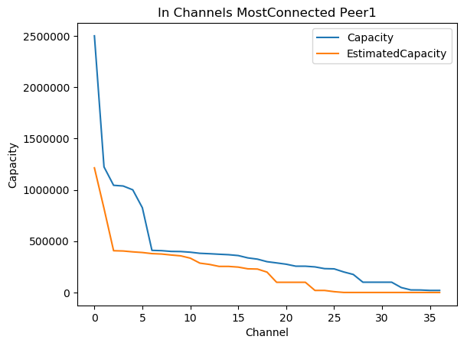
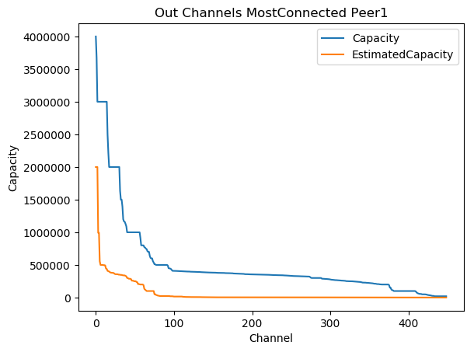
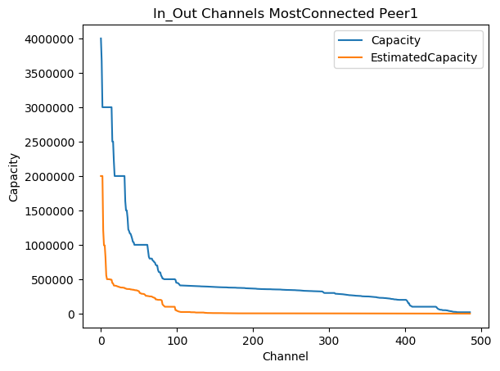
Mainnet Result: Peer1 MostConnectedPeer
NB: 500000 Sat = 23.77 €

Slide 15
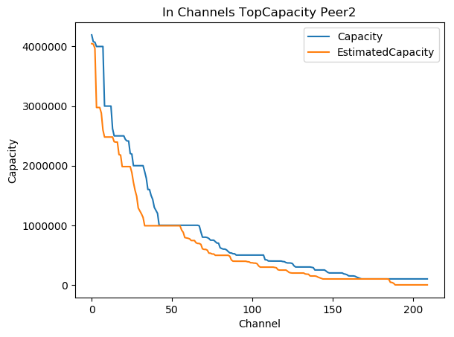
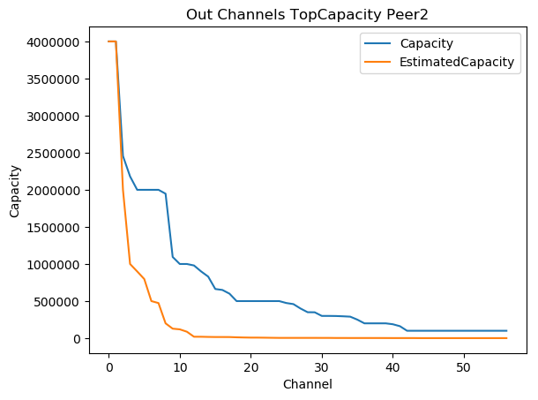
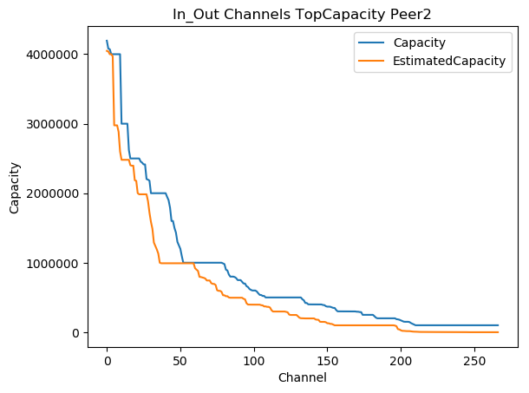
Mainnet Result: Peer2 TopCapacityPeer

Slide 16
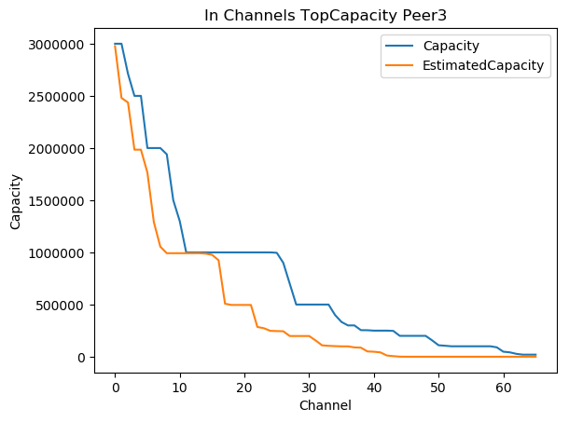
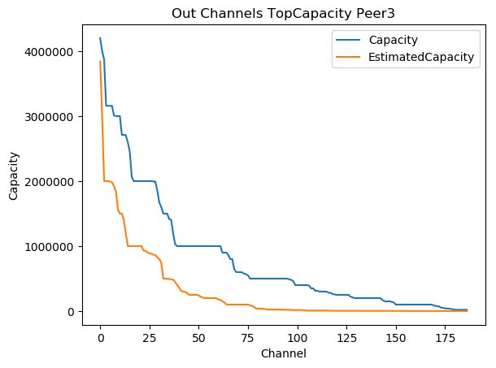

Mainnet Result: Peer3 TopCapacityPeer

Slide 17
Mainnet Result: Next Step Selection
Nx
Ni
OR
Nx
Ni
N0
N0
Nx
Ni
OR
Nx
Ni
N0
N0

Slide 18
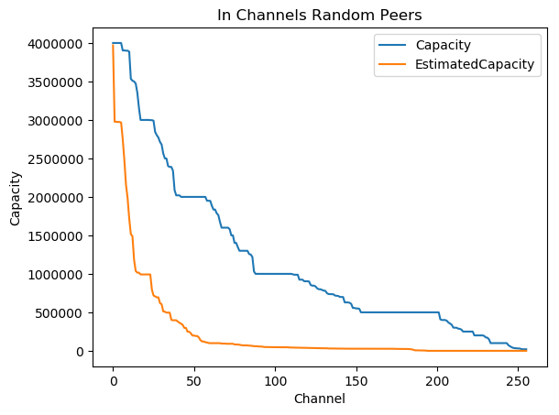
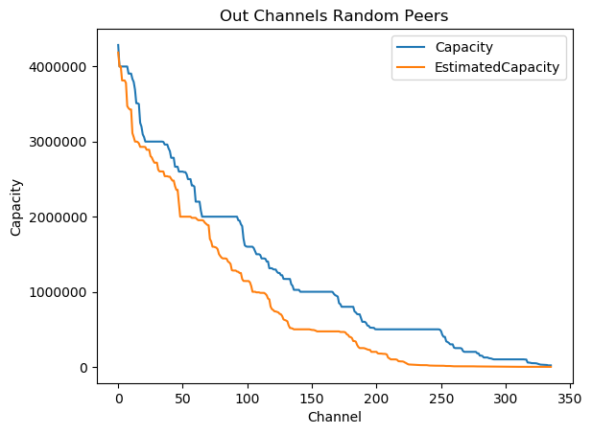
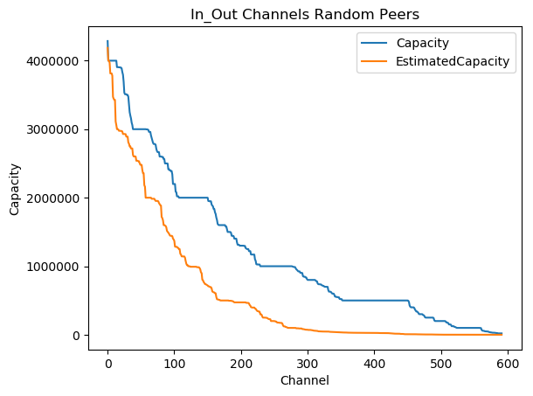
Mainnet Result: PeersNi

Slide 19
Channel Intersection Stats
Number of Channel 14.
Expected Results:
A: λ12 + λ21 = Λ
B: λ12 + λ21 <= Λ + Λ*2/100
C: λ12 + λ21 >= Λ + Λ*2/100 →Local and Remote Balance have changed in Time
N.B. InOut referring to MostConnected and TopCapacity Peers
Results:
A: 0
B: 5 →36%
C: 9 → 64%
Results In Out:
A In Out: 0
B In: 3 →22%
B Out: 2 →14%
C In: 8 →57%
C Out: 1 →7%

Slide 20
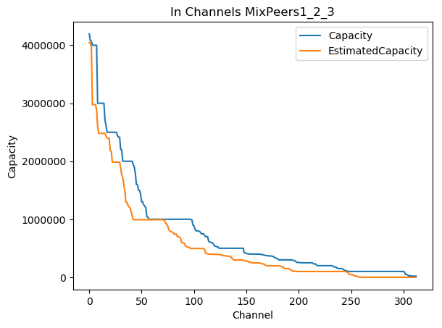
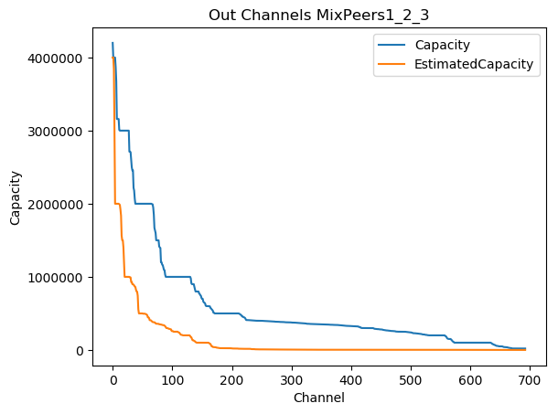
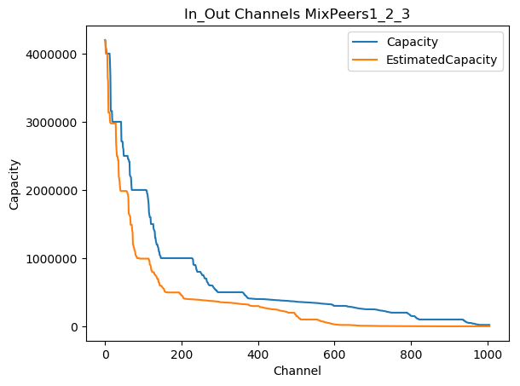
Mainnet Result: Peers 1 2 3

Slide 21
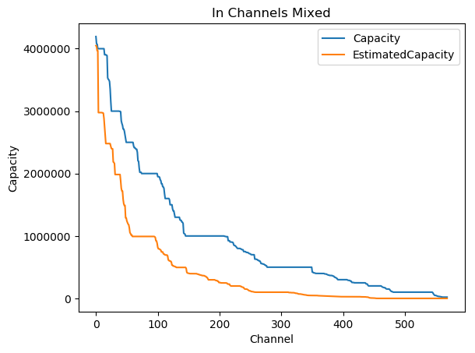
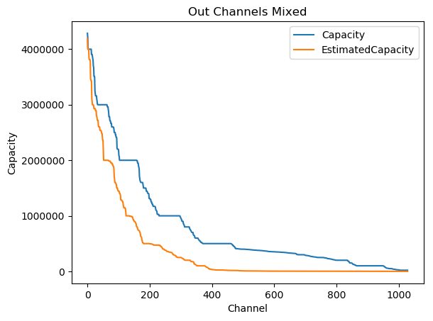
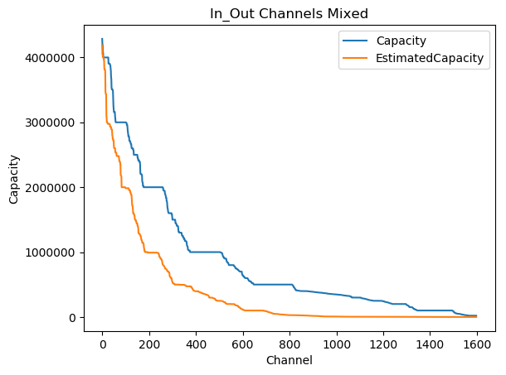
Mainnet Result: Mixed Peers

Slide 22
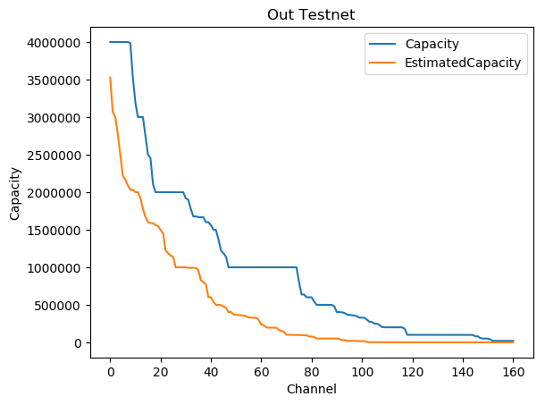
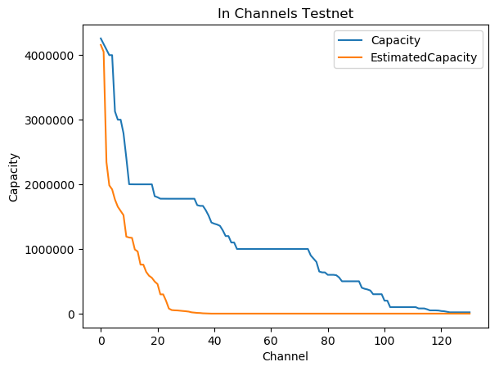
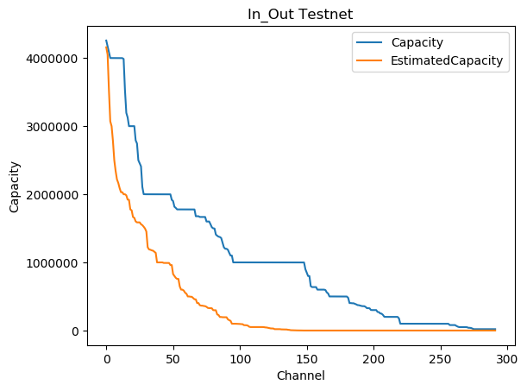
Testnet Result

Slide 23
Validation
B: Capacity: 50000
Capacities are expressed in Satoshi 1 Sat= 1 BTC/ 10^8
Y
W
A: Capacity: 100000
C: Capacity: 30000
X
Z
Payment Direction | Command | Amount | Expected Result | Result
1: X -> W | queryroutes | 40000 | Ok | Ok
2: X -> W | queryroutes | 50000 | Ok | Ok
3: X -> W | queryroutes | 50010 | Unable to find Path | Unabel to find Path
4: X -> W | queryroutes | 60000 | Unable to find Path | Unable to find Path
5: X -> Y | queryroutes | > 98816 & <100000 | Ok | Unable to find Path
6: X -> Y | queryroutes | < 98816 | Ok | Ok
7: X -> Z | queryroutes | 40000 | Unable to find Path | Unable to find Path
8: X -> Z | queryroutes | 30000 | Ok | Ok
9: X -> Z | queryroutes | 30010 | Unable to find Path | Unabel to find Path

Slide 24
Validation
B: Capacity: 50000
Capacities are expressed in Satoshi 1 Sat= 1 BTC/ 10^8
Y
W
A: Capacity: 100000
C: Capacity: 30000
X
Z
Payment Direction | Command | Amount | Expected Result | Result
10: W -> X | queryroutes | anything | Unable to find Path | Unable to find Path
11: W -> Y | queryroutes | anything | Unable to find Path | Unable to find Path
12: Y -> X | queryroutes | anything | Unable to find Path | Unable to find Path
13: Z -> N | queryroutes | anything | Unable to find Path | Unable to find Path

Slide 25
Next Steps
Complete Validation
Con la información de rutas, me gustaría saber el balance de los funding transactions de cada nodo. La motivación es la siguiente: hemos visto que peer1 parece que ha transferido mucho dinero al resto (mucho más que lo que ha recibido). Quiero saber el balance de las funding transactions: suma del valor de las funding transactions generadas por un nodo – suma valor de las funding transactions hechas por otros nodos que terminan aquí. Quiero ver la relación de este balance con el número de canales que tienen
Implementar el ‘algoritmo mejorado’. Está descrito en el repositorio del paper, fichero measures_bis.tex. Probar que funciona…
Hay algún repositorio de las rutas de lightning guardadas cada cierto tiempo?

Slide 26
Next Steps
N1 ->N2 --> N3 <-N1'
Measure C23 at same time with two different nodes.
Verify if the difference between LocalBalance and what you can queryroutes for depends on the InitialChannelBalance
Verify if we can now under which daemon is working the other node
Verify Bilaterals channels. Can N1 decide where to forward N3 payment?
N1
N0
N2

